Slide 1
This Presentation is Presented by:
Vikas Arora
Development Officer

Slide 2


The Profession of
LIFE INSURANCE CONSULTANT
Of

Slide 3

Life Insurance Agency is considered today as
the Highest paid profession in the world.

Slide 4

Earning Opportunities
There is no restriction to the amount of
Money that one can earn.

Slide 5




People have entered this profession
from all walks of life.
There are:
Doctors,
Engineers,
C. A.’s,
Share Brokers,
Lawyers,
Film-stars,
CEO’s,
Businessmen,
House Wives,
Students &
…Many Others…

Slide 6
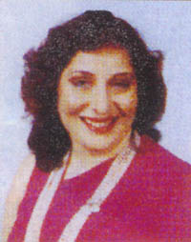
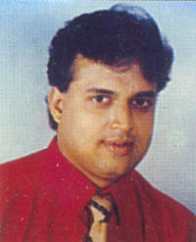
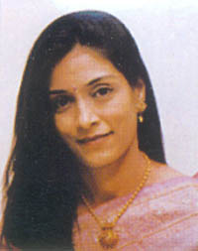
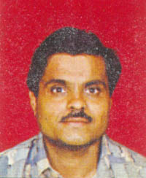
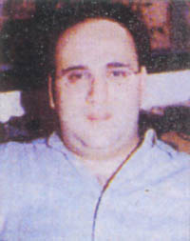
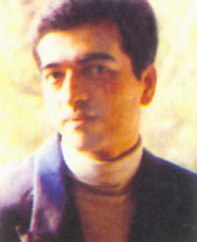
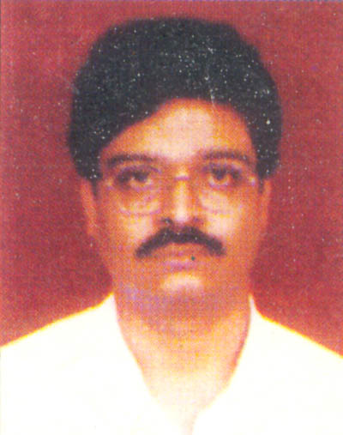
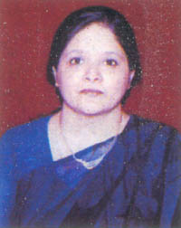
Profile of some of
OUR TOPERS (All INDIA)
Smt. Ritu Nanda
63,12,399 (TOT)
Shri R. S. Satoskar
30,26,058 (TOT)
Smt. C. V. Bheda
30,35,450 (TOT)
Shri S. B. Choudhary
2,17,95,429 (TOT)
Shri Sanjeev Bajaj
55,74,860 (TOT)
Shri Jayeep M. Kashikar
30,00,477 (TOT)
Photo from MDRT Book
Shri J. Kannan
34,35,713 (TOT)
Smt. U. Goenka
37,97,965 (TOT)

Slide 7
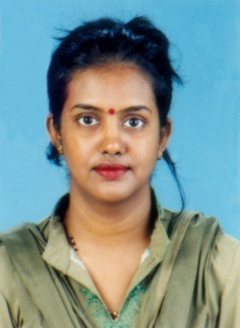
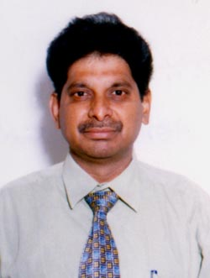
Profile of our Team Topers
USHA JAIN
MDRT
JOGINDIRI DEVI
(126 Policies)
DHAWAN
MDRT
ARUKIA
101 Policies
PARVESH KUMAR
ZM CLUB
MANISH JAIN
M.D.R.T.
SUBHASH
4,88,000
SUNITA SWAROOP

Slide 8
Commission Rates
On any standard Policy that you procure, you shall be paid
the following Commission Rates:
• 25% of 1st year premium with 10% Bonus Commission.
• 7.5% of 2nd & 3rd year premium.
• 5% there after till the Policy Continues.
Every time a Policyholder pays his Installment Premium,
the Agent receives his Commission.

Slide 9
THAT MEANS
YEAR
PREMIUM
%
COMMISSION
1st
2nd
3rd
4th
5th
6th
7th
8th
9th
10th
11th
12th
13th
14th
15th
16th
17th
18th
19th
20th
10,000
10,000
10,000
10,000
10,000
10,000
10,000
10,000
10,000
10,000
10,000
10,000
10,000
10,000
10,000
10,000
10,000
10,000
10,000
10,000
2,00,000
35%
7.5%
7.5%
5%
5%
5%
5%
5%
5%
5%
5%
5%
5%
5%
5%
5%
5%
5%
5%
5%
3,500
750
750
500
500
500
500
500
500
500
500
500
500
500
500
500
500
500
500
500
Total Commission on 1 Policy 13,500

Slide 10
SELL BIG INSURANCE BE SELECTIVE
1 Cr. Policy
YEAR
PREMIUM
%
COMMISSION
10,00,000
10,00,000
10,00,000
10,00,000
10,00,000
10,00,000
10,00,000
10,00,000
10,00,000
10,00,000
Total Paid 1,00,00,000
1st
2nd
3rd
4th
5th
6th
7th
8th
9th
10th
21%
7.5%
7.5%
5%
5%
5%
5%
5%
5%
5%
2,10,000
75,000
75,000
50,000
50,000
50,000
50,000
50,000
50,000
50,000
7,10,000
Total Commission
Earned by agent

Slide 11
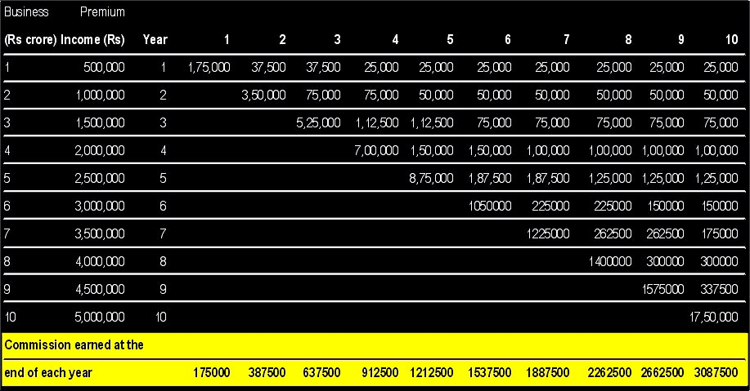
Magic of Renewal Commissions
Total Premium Collection - 2,75,00,000
Total Renewal commission@5% will be 13,75000 P.A.
Recurring Consistent Income 1,14583 P.M.
SOURCE
Business standard
24th September 2001.

Slide 12

You Create your own Pension:
As Years pass by,
the Renewal Commission starts building up.
There by assuring you a pension for the next 20 to 25 Years & the Beauty of it is...
“ Hereditary Income”

Slide 13

Club Membership
..is recognition given for Outstanding Performance by Agents.
• Distinguished Club Membership
• Branch Manager’s Club Membership
• Divisional Manager’s Club Membership
• Zonal Manager’s Club Membership
• Chairman’s Club Membership

Slide 14
Fringe Benefits to
Club Membership
• Interest free Advance for 2 wheeler or 4 wheeler.
• Interest free Advance for purchases of Personal
Computer, Furniture, Telephone etc.
• Housing Loan at the rate of 5.25% p.a.
• Reimbursement of expenses on Stationery Office
and Sales Promotion, Gift Items.
…And Many More.

Slide 15
Benefits Quantified
• Office Expanses 30,000
• Sales Promotional Expenses 1,400
• Festival Advances 7,000
• Letterhead, Envelopes 1,000
• Housing Loan (3.75 lacs@5.25%) 18,750
• Car Advance (4lacs) 42,000
• Computer Advance-50,000 5,250
• Computer Maintenance Allowance 6,000
• Telephone 12,000
• Advance for Purchase/Repair of Office 21,000
• Expenses for Conven 25,000
• Out of Pocket Expenses 2,500
TOTAL 1,71,900
Free Term Insurance 1,25,000
Gratuity 2,00,000
Training Expenses if Nominated by LIC
We take at most care of our Agents

Slide 16
International Recognition
M.D.R.T
COT
TOT
7,59,100 Commission
22,77,300 Commission
45,54,600 Commission
FLY TO U.S.A. Every Year…

Slide 17
ALL THE DREAMS
OF YOUR LIFE
CAN COME TRUE
A T L I C
Unlimited Income
Two / Four Wheeler
Dreamed House
Dreamed Office
Status in Society
International Status
Job Satisfaction
Pension For Generation
Help to the Nation
Peaceful Life

Slide 18
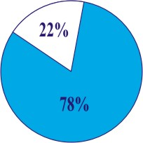
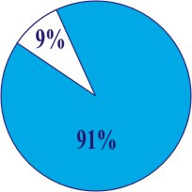
Coming together is Beginning...Working together is Progress...Staying together is Success...
FROM 35,000 CR. IN 2002 TO 200,000CR. UPTO 2010.
Individual Insurance
Corporate Insurance
KEYMAN - PARTNERSHIP - EMPLOYER - EMLPOYEE
In India only 22% population is
insured till date.
Balance 78% insurable
Population is yet to be Insured.
Only 9% Insurable Co.’s
Have taken corporate Insurance till Date.
Balance 91% Insurable Co.’s are yet
to be tapped.
THERE IS A VAST POTENTIAL UNTAPPED MARKET FOR INSURANCE

Slide 19
Qualities you should Develop…
Continuous Knowledge update
Develop Relations & Contacts
Positive Attitude
Consistency in meeting People
Great Patience

Slide 20
Role to be Performed
Prepare a list of People
Introduce yourself to them
Approach them Professionally
Present them New & Innovative ideas/concepts
Our executive will help you
At every step

Slide 21
How much time should one
Devote to this BUSINESS
It’s a parallel profession.
Which goes with your presents
Service / Business / Profession
YOU NEED NOT DEVOTE
SEPARET TIME FOR IT…

Slide 22
Our SUPPORT
Customized Training
Through Product Knowledge
Effective Skills & Marketing Ideas
Personal Counseling
Regular Monitoring &
Strong Back Office Support
- Office Staff
- Assistant
- Training Executives
- Marketing Executives

Slide 23
The Procedure to become a
Life Insurance Agent
• Qualification : Graduate.
• Formal training for a period of 50 hours.
• To Qualify Examination conducted by the
Insurance Institute of India.
• Personal Interview.
• Issue of Licence by the I.R.D.A.

Slide 24
Our Organisational Strength
CENTRAL OFFICE
YOGAKSHEMA
Zonal Offices
EAST/ECZ
(Kolkata/PATNA)
WEST
(Mumbai)
SOUTH
(CHENNAI)
NORTH
(DELHI)
CENTRAL
(Bhopal)
N. CENTRAL
(Kanpur)
S. CENTRAL
(Hyderabad)
CONNAUGHT PLACE
DELHI-I
31-C
ALL INDIA
ZONES - 8
DIVISIONS - 108
BRANCHES - 2048
STAFF - 1,23,000
DO’s - 30,000
AGENTS - 13,00,000

Slide 25
A Life Insurance Agent renders a Social Service to families, as well as generates funds for...
LIC’s investments some high lights...
fig. in Crores
Central Govt. Securities 318673
State Govt. Securities 110697
Electricity 44358
Housing 34185
Water supply 6022
State Road 2700
Loans to Ind. Estates 450
Loans to sugar co-op. 370
Dev Authority 113
Port, Railway, Roadway 6022
Power generation 9797
Municipality 70
5,30,159
(Ref. 2009 LIC diary)
Nation Building Activities

Slide 26
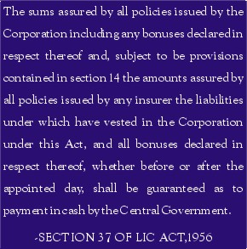
Govt. Guarantee & Financial Strength
Working Results (Rs. In Crore)
Premium Income 1,49,706
Other Income 21,110
Income from Investment 1,22,695
Total Income 2,93,511
Commission & Adm. exp. 18,677
Claims 57,623
Total Expenses 76,300
Reserve Fund 6,86,616
Total Assest 8,03,820
Policies to be guaranteed by
Central Government
Ref. LIC diary 2009.

Slide 27
Thank you very much for...
taking the opportunity to go through a Wonderful Career as a Life Insurance Agent for LIC OF INDIA
Vikas Arora
-Development Officer

